Slide 1
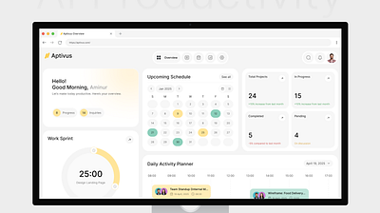
AI Commerce Automation
Turn Product Content
Into Revenue—Automatically.
AutomateLabs builds AI workflows for e-commerce stores: product videos, catalog enrichment, ad creatives, and customer flows—without expensive teams.
Shopify
WooCommerce
Meta Ads
Book Free Audit
See E-Com Systems

Slide 2
Pain → Opportunity
The e-commerce operations that drain your team's time are exactly where AI automation delivers the biggest ROI.
Current Pain Points
Business Impact
Listing creation takes forever — Manual product uploads eat up hours per SKU
More time-to-market — Delayed launches cost you revenue every week
Creatives don't scale with SKU count — Video production costs balloon with inventory
Lower conversion rates — Poor creatives and copy kill purchase intent
Product pages lack consistency — Copy quality varies, hurting brand trust
Higher creative costs — Agencies and freelancers drain margins
Manual catalog ops = slow launches — Competitors beat you to market
Team burnout risk — Repetitive tasks kill morale and productivity
If your store has SKUs, you need automation.

Slide 3
Automation #1
3D Product Video Generator
Transform 2D images into stunning 3D video spins—automatically
Workflow Pipeline
Benefits
Create videos for every SKU — No more manual editing or expensive agencies
1
Input: 2D Product Images
Upload from Shopify, Dropbox, or Google Drive
Consistent style + branding — AI applies your brand guidelines automatically
AI Generates 3D Spin + Video Variants
Faster ad testing — Generate multiple variations in minutes, not days
2
Multiple angles, lighting, and motion templates
10x engagement boost — 3D spins increase conversion up to 27%
3
Export for Ads + Product Detail Pages
Auto-optimized formats for Meta, TikTok, Shopify
Typical setup cost:
Low
Where it runs
Creator-replacement economics
Shopify/WooCommerce + Drive/Dropbox + Meta/TikTok Ads

Slide 4
Automation #2
Product Fine-Tuning for Better Listings
AI-powered copy that outranks competitors—learned from their data
AI Learning Pipeline
Data Collection
AI Fine-Tuning
Smart Output
Bright Data pulls competitor pages, reviews, pricing
OpenAI trains on winning copy patterns
Optimized titles, bullets, SEO, FAQs for your catalog
Benefits
Starting at:
$299/mo
Higher-quality copy at scale — Every product gets expert-level descriptions
Replaces $3k+/mo copy team
Better SEO + discoverability — AI targets proven keywords that convert
Consistent tone across catalog — Brand voice stays uniform across 1000s of SKUs
35% average CTR improvement — Data-driven copy beats human writing
Compliance
Respects platform rules; configurable data sources. No scraping violations.

Slide 5
Full Automation Menu
What Else We Automate
End-to-end e-commerce workflows — pick what you need or automate everything
Product Descriptions + SEO
Image Cleanup + Resizing
Ad Creative Variations
Auto-generate compelling copy optimized for search and conversions
Background removal, quality enhancement, multi-format exports
Generate multiple ad angles with auto-written captions
Inventory/Price Alerts
Review → FAQ Automation
Cart Recovery Flows
Real-time monitoring with Slack/email notifications
Summarize reviews into PDP FAQs that boost conversions
Abandoned cart + post-purchase follow-up sequences
Works with all your tools:
Shopify
•
WooCommerce
•
Klaviyo
•
Meta Ads
•
Google Sheets
•
Airtable
•
Zapier/Make
•
APIs

Slide 6
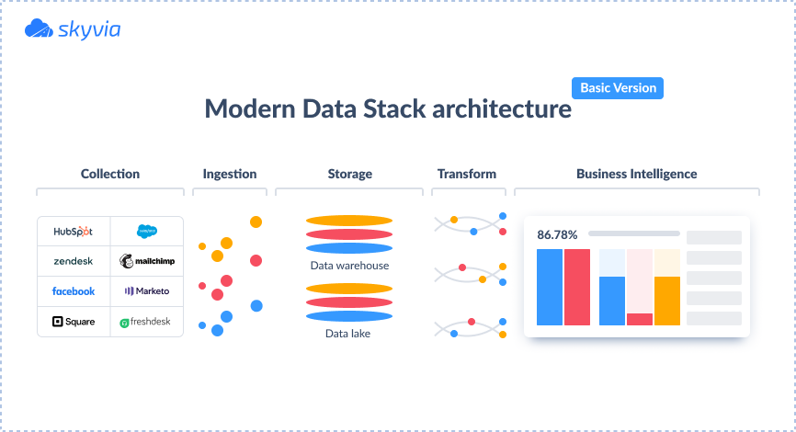
Get Your First Automation Live in 7 Days
Start with one workflow, scale up anytime — no long-term contracts
Most Popular
Starter
Growth
Scale
$299
$799
$1,999
/mo
/mo
/mo
Perfect for getting started
Full automation suite
Enterprise-grade solution
1 automation workflow
Video + listing pipeline
Full catalog engine
2 platform integrations
5 platform integrations
Custom SaaS mini-portal
Up to 500 SKUs
Up to 5,000 SKUs
Unlimited SKUs
Email support
Analytics dashboard
White-label available
Priority support
Dedicated account manager
Get Started
Start Growing
Book Demo
Ready to Scale Without Hiring?
Request Callback
Save 10–20 hours/week
Scale creatives without hiring
Launch products faster

